Slide 1
________________________ ,, ________________________
Image Sensor
(SG Mount, SGDG)
Standard time and Improvement
________________________ ,, ________________________

Slide 2

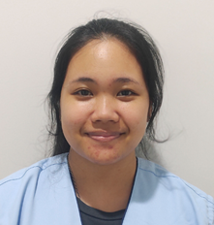
Introduce Myself
Name Sirada Yimsawat
Nickname Tong
ID S2022013
Education King Mongkut’s University of Technology North Bangkok
Major Industrial Engineering
Internship Sony Device Technology (Thailand) Co.,Ltd
Division Production Engineering

Slide 3
Internship Schedule
Task list | P/A | May |  |  |  |  |  |  |  | June |  |  |  | June |  |  |  |  |  |  |  |  |  |  |  |  |  |  |  |  |  | July |  |  |  | July
 |  | Week1 |  |  |  |  | Week2 |  |  |  |  |  | Week3 |  |  |  |  | Week4 |  |  |  |  | Week5 |  |  |  |  | Week6 |  |  |  |  | Week7 |  |  |  |  | Week8 |  |  |  |  | Week9 |  |  |  |  | Week10
 |  | 23 | 24 | 25 | 26 | 27 | 30 | 31 | 1 |  | 2 | 3 | 6 | 7 | 8 | 9 | 10 | 13 | 14 | 15 | 16 | 17 | 20 | 21 | 22 | 23 | 24 | 27 | 28 | 29 | 30 | 1 | 4 | 5 | 6 | 7 | 8 | 11 | 12 | 13 | 14 | 15 | 18 | 19 | 20 | 21 | 22 | 25 | 26 | 27
1. Orientation | Plan
 | Actual
2. Line tour | Plan
 | Actual
3. Issue flow process | Plan
Chart, IPO and flow diagram | Actual
4. Video record | Plan
 | Actual
5. Create standard time, Pareto graph | Plan
and analysis | Actual
6. Process improvement | Plan
 | Actual
7. Create report and Final presentation | Plan
presentation | Actual
 |  |  | Plan |  |  |  | Actual |  |  |  |  |  | Delay
TODAY
Holiday

Slide 4


Responsible Business
Responsible Business
Responsible business is Image Sensor in part of SG Mount and SGDG
Prepare Materials
Assembly
Inspection
Wafer
Seal Glass
B-Frame
Seal Glass
SGMT
SGDG
SGPS
Mount
Change Blade (Z1,Z2)
Prepare, Start lot,
Operation, Record,
End lot
Response by Siriwat
Prepare, Operation,
Record, Measurement

Slide 5

. . . . . . . .
. . . . . . . .
SG Mount
AGENDA
IPO
Flow Operation
3) Flow Diagram
4) Report of Process

Slide 6
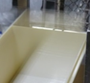
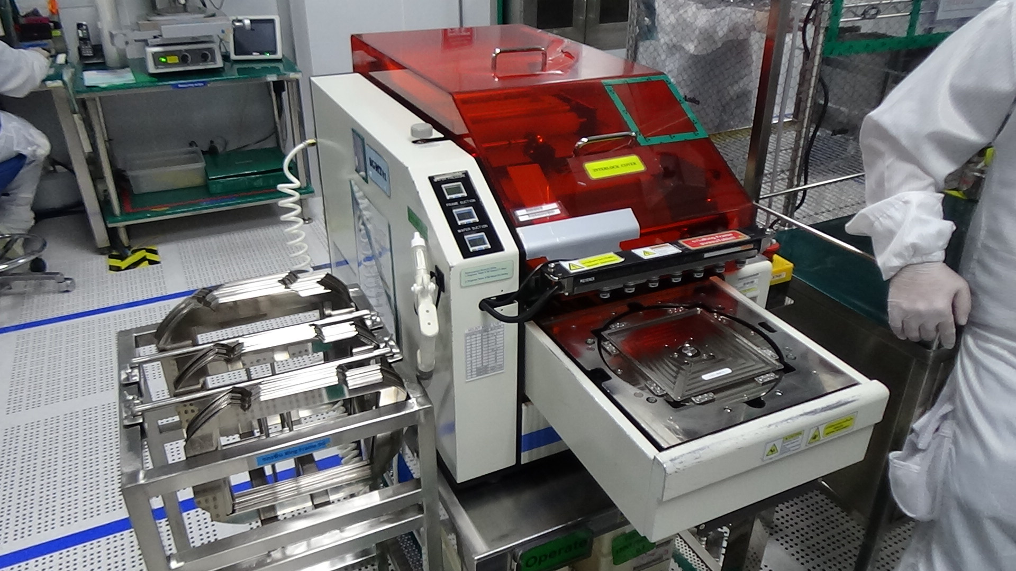
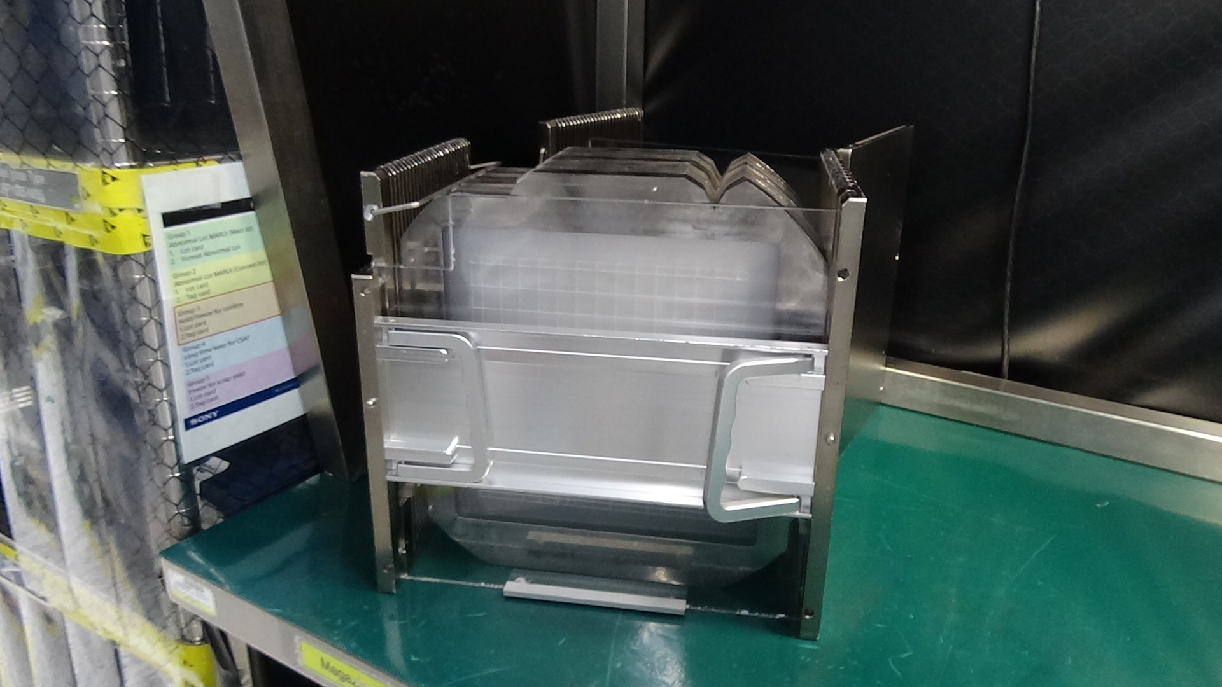
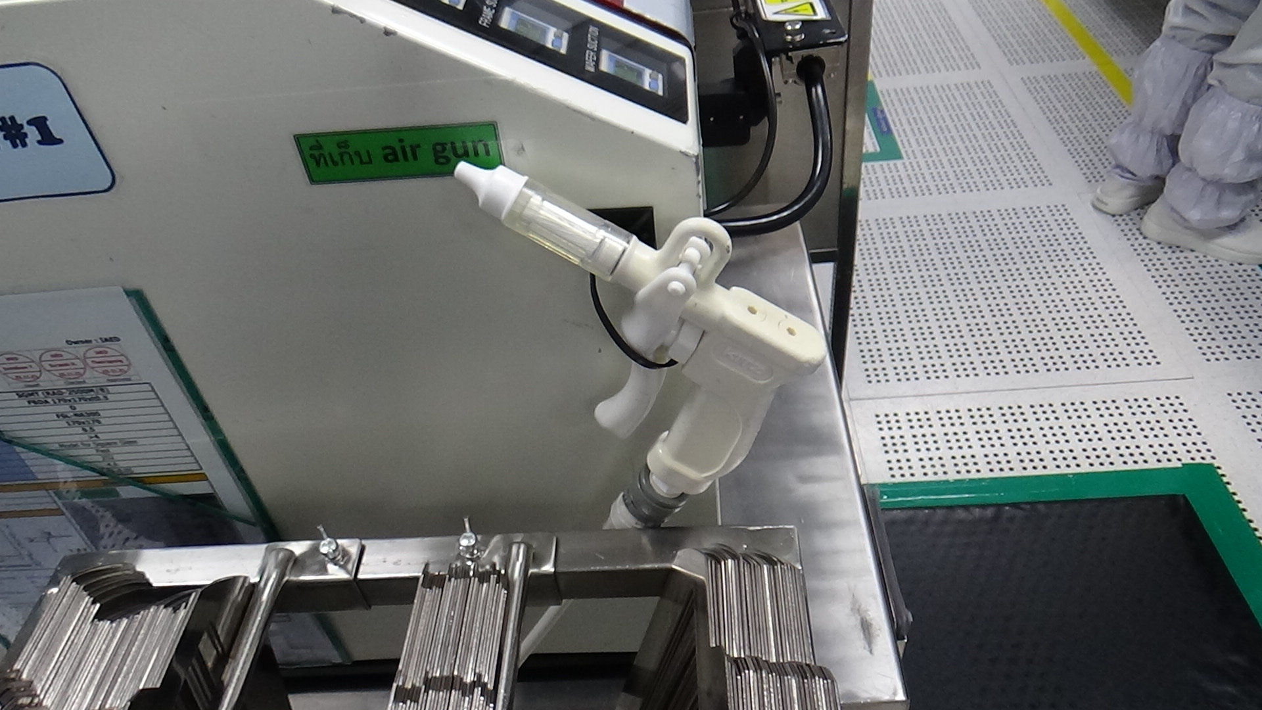
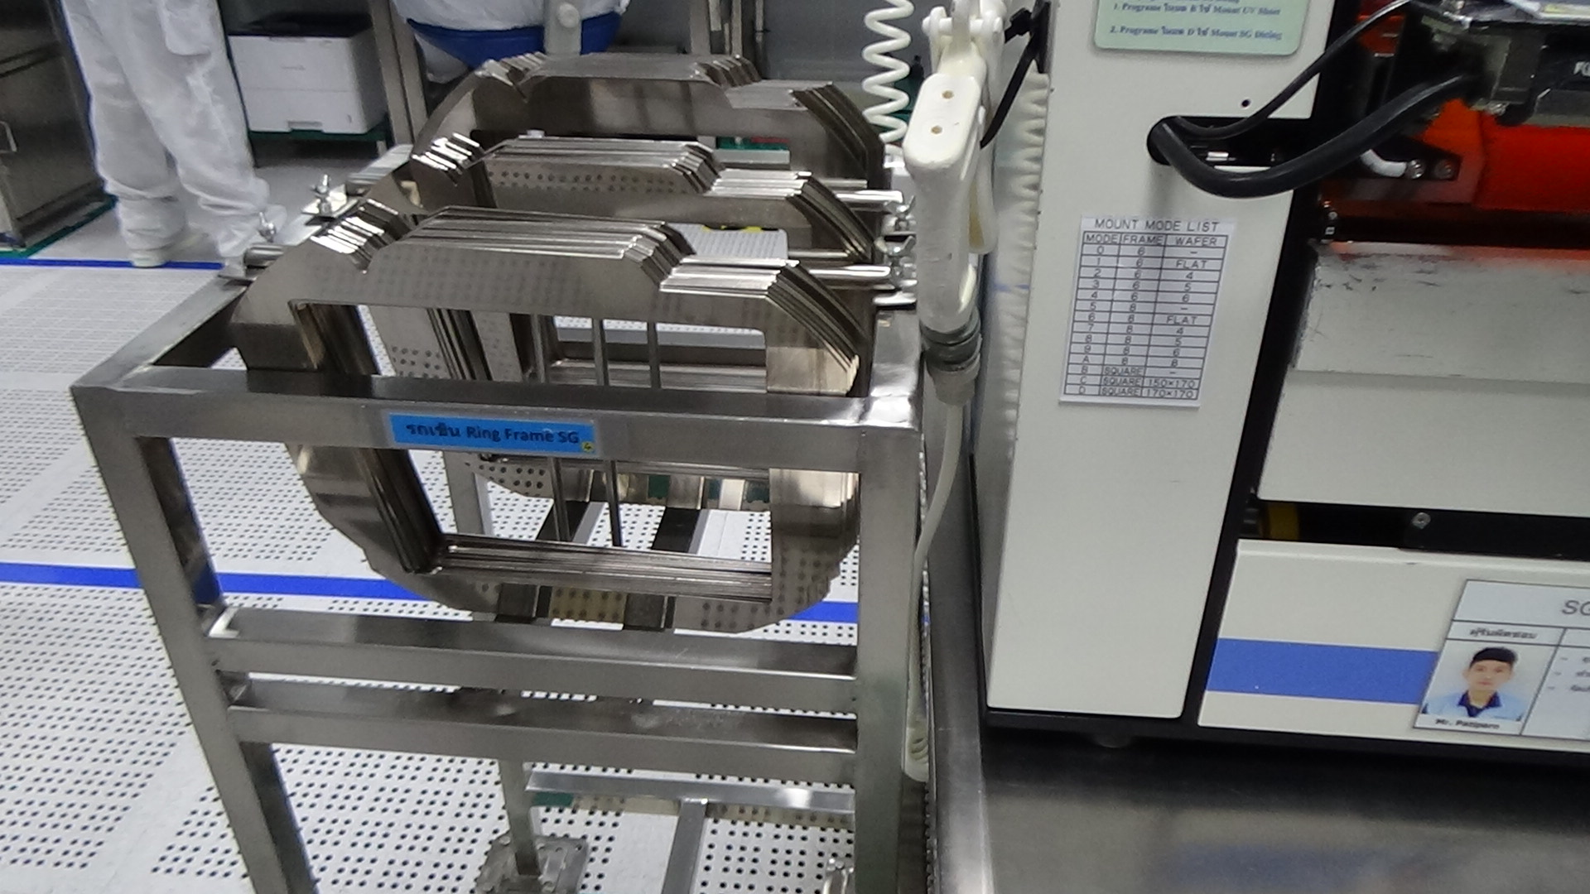
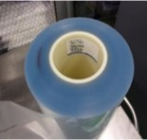
IPO of SG Mount
Input
Process
Output
Plate Glass
Ring Frame
Plate glass after Mount process in magazine
1. Take plate glass into ring frame and use air gun to clean surface
2. Run machine to mount plate glass with UV sheet and ring frame
3. Put plate glass after mount into magazine
UV sheet

Slide 7
SG Mount
Standard time summary
Flow Operation
SG Mount has 3 activities, 38 elements and total average time is 41 minutes 37 seconds
Plate Glass box from W/H
PREPARE
Activity | Element | Plan (times) | Standard time (mm:ss) |  |  | Average time (mm:ss) | Frequency / lot | Total time / lot (mm:ss)
 |  |  | 1st | 2nd | 3rd
1. Prepare | 17 | 3 | 03:49 | 04:36 | 04:23 | 04:16 | 1 | 04:16
2. Mount | 7 | 3 | 28:21 | 27:02 | 35:15 | 30:12 | 1 | 30:12
3. After (End lot, Record) | 14 | 3 | 06:35 | 06:59 | 07:52 | 07:09 | 1 | 07:09
Total | 38 | 12 | 38:44 | 38:37 | 47:31 | 41:37 |  | 41:37
MOUNT
END LOT
RECORD
1 lot = 40 slices
SGDG

Slide 8
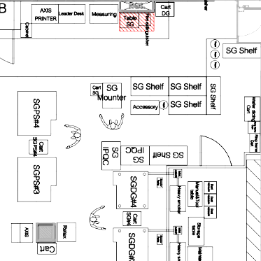
Flow Diagram of SG Mount
From flow diagram, Total transportation distance is 88.8 meter and
Total transportation time is 2 minutes 36 seconds
1
3
 | Area of unpacking plate glass box from W/H
 | Shelf store plate glass box
 | Leader table to print lot card
 | Mount table
 | Shelf store empty magazine
 | Ring frame cart
 | Computer desk
 | Shelf store magazine after mount
1
8
2
2
PREPARE
Distance = 54 m
Transportation time = 1:35 (mm:ss)
5
4
6
3
4
OPERATION
Distance = 0 m
Transportation time = 0 sec
7
5
6
Operation
AFTER (End lot, Record)
Distance = 34.8 m
Transportation time = 1:01 (mm:ss)
7
Transportation
8

Slide 9
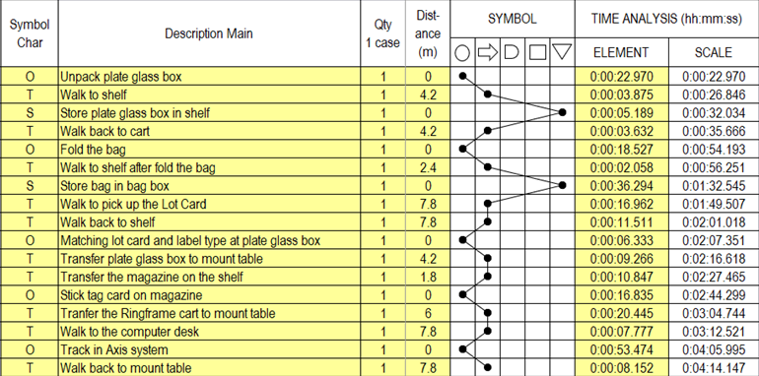
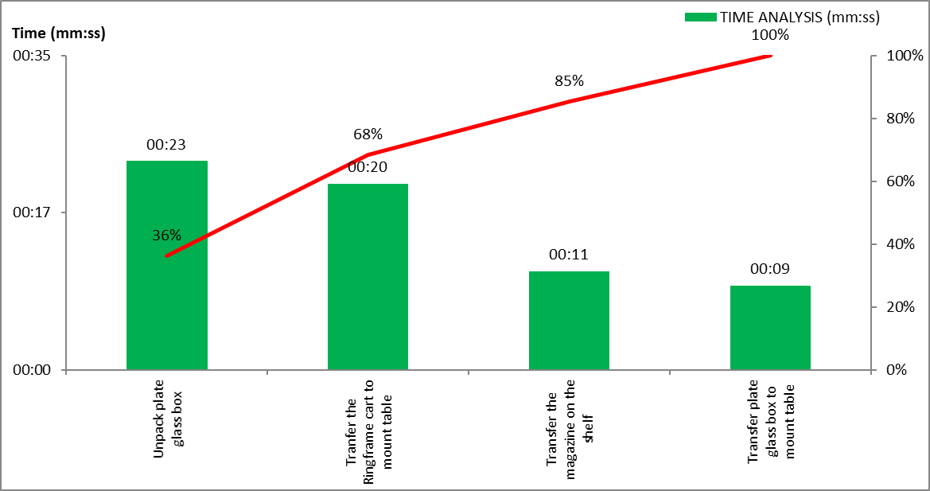
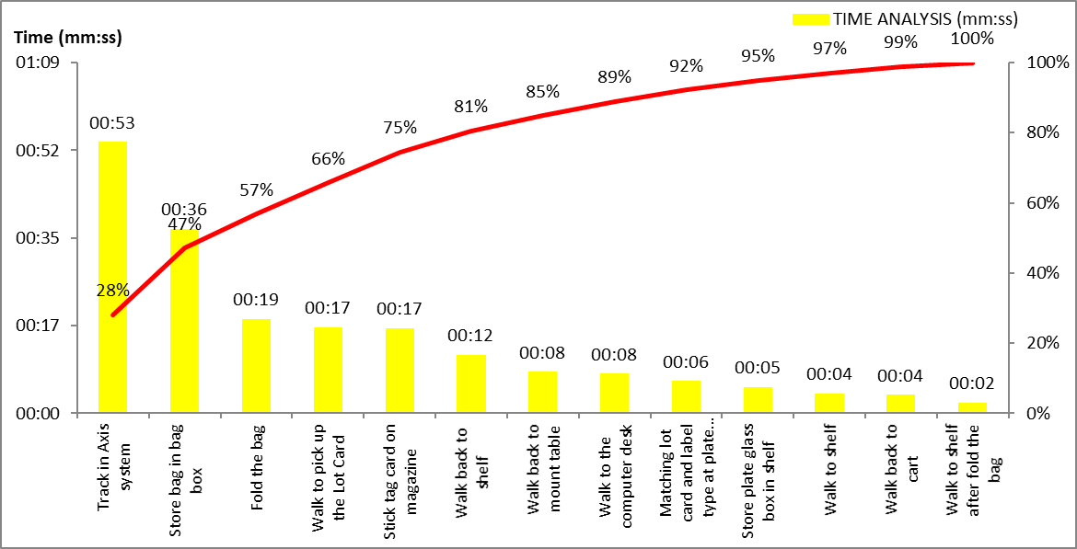
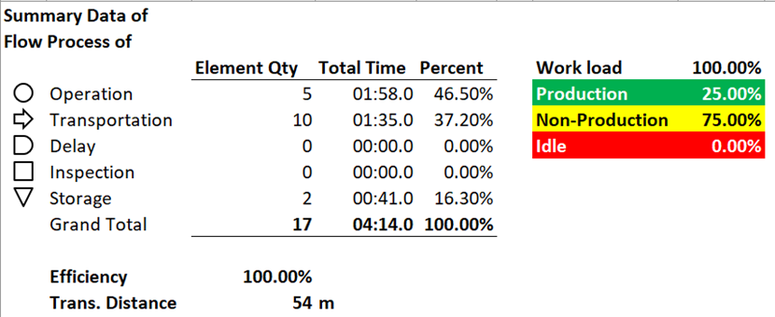
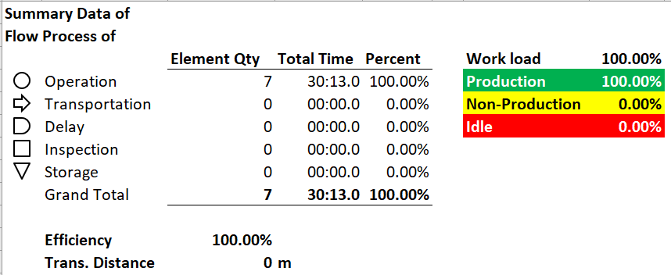
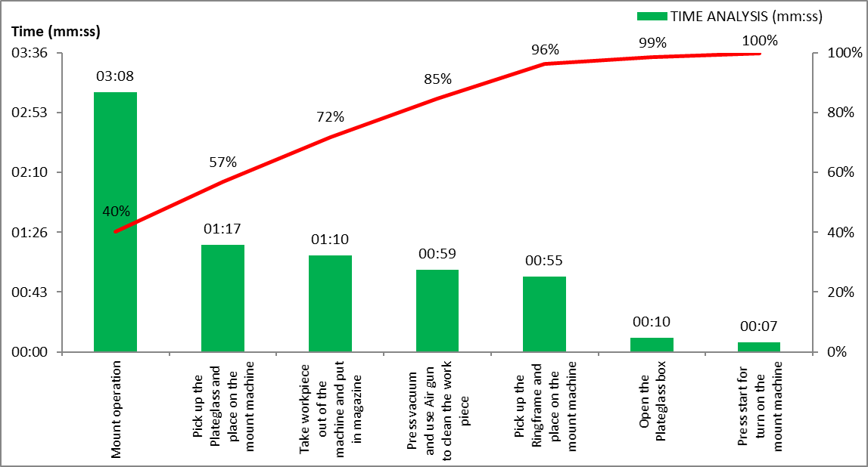
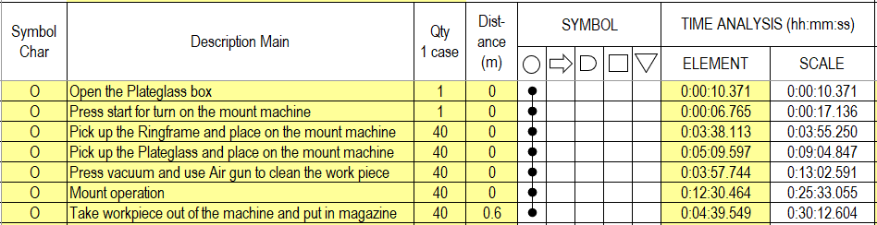
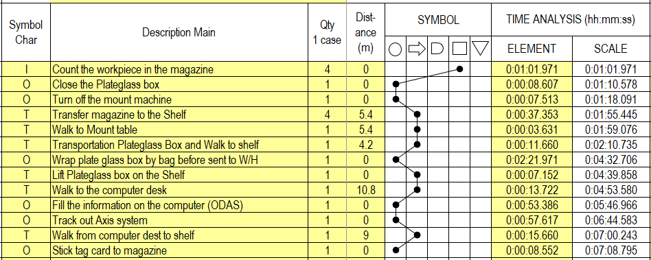
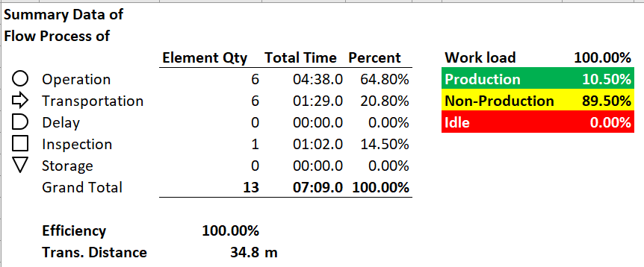
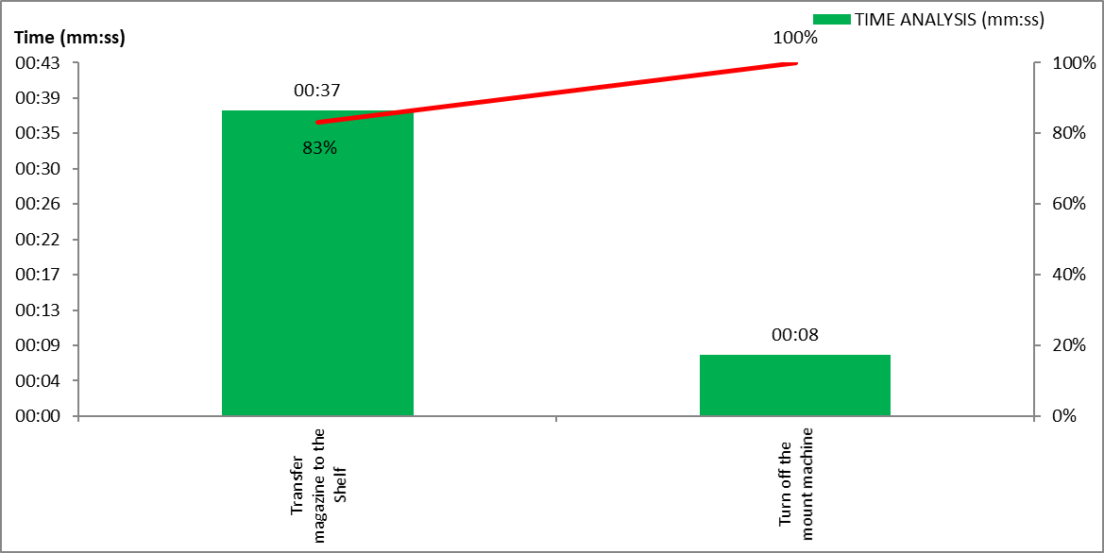
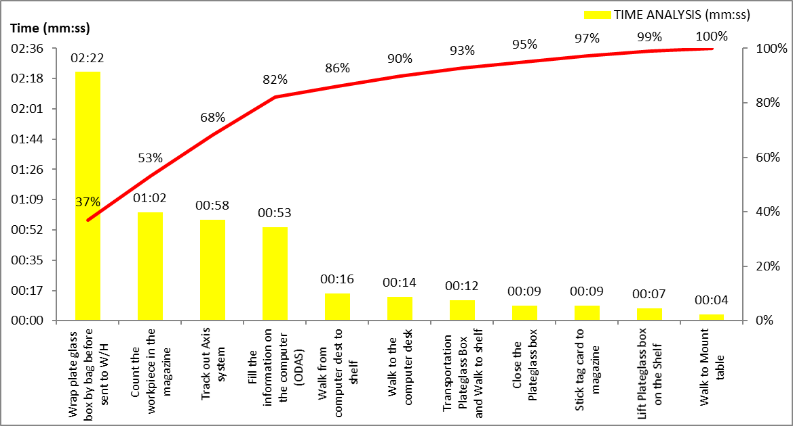
REPORT OF SG Mount
From workload analysis has chosen Prepare activity to improvement
Activity | Direct time analysis | Report | Production | Non-production | Idle
Prepare |  |  |  |  | -
Operation |  |  |  | - | -
After (End lot, Record) |  |  |  |  | -

Slide 10
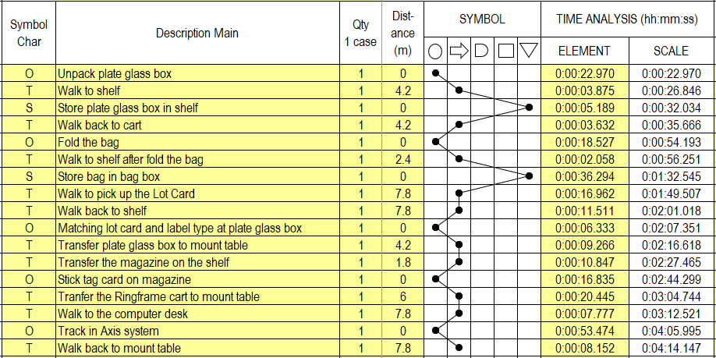

REPORT of PREPARE SG Mount
From flow process chart, will get 5 symbols of process chart and
Pareto graph. So, operation activity has production 25.0%, non-production
75.0% and idle 0%
Pareto graph
Flow process chart : Direct time analysis
Report

Slide 11
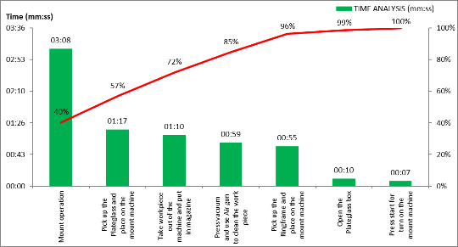
REPORT of OPERATION SG Mount
From flow process chart, will get 5 symbols of process chart and
Pareto graph. So, operation activity has only production 100% and
Mount operation element is the most time to use in operation
Flow process chart : Direct time analysis
Pareto graph
Report

Slide 12
REPORT of AFTER SG Mount
From flow process chart, will get 5 symbols of process chart and
Pareto graph. So, operation activity has production 10.5%, non-production
89.5% and idle 0%
Pareto graph
Flow process chart : Direct time analysis
Report

Slide 13
. . . . . . . .
SG Dicing
(Change Blade)
. . . . . . . .
AGENDA
IPO
Flow Operation
3) Flow Diagram
4) Report of Process

Slide 14
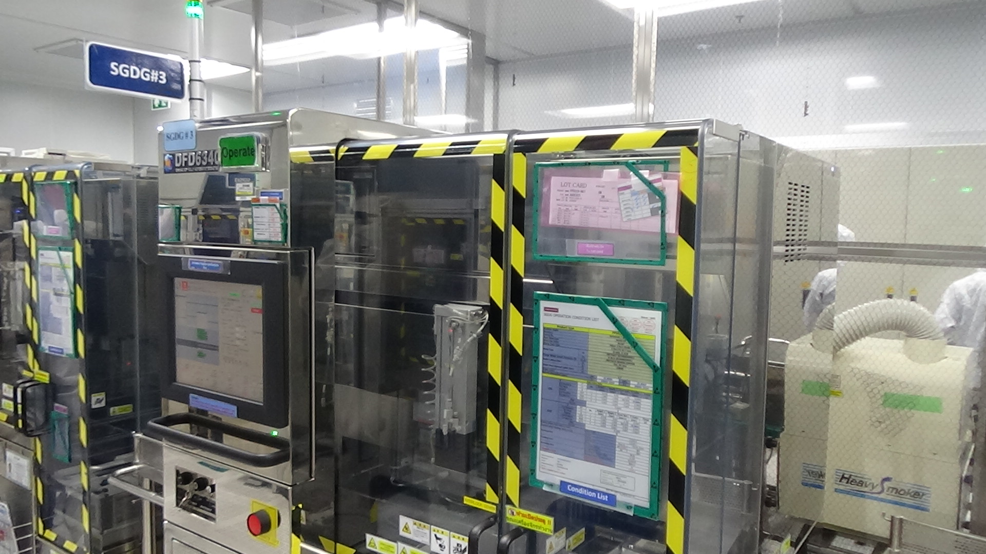
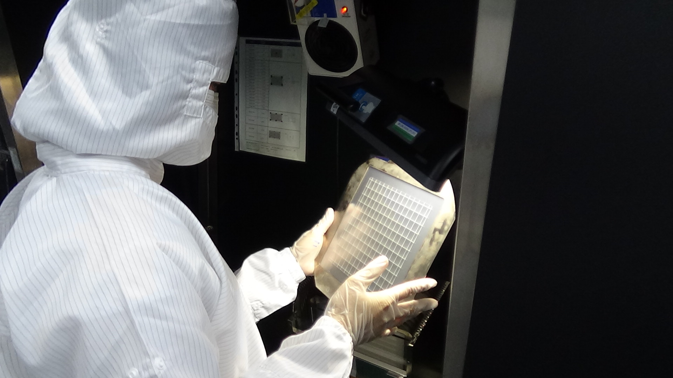
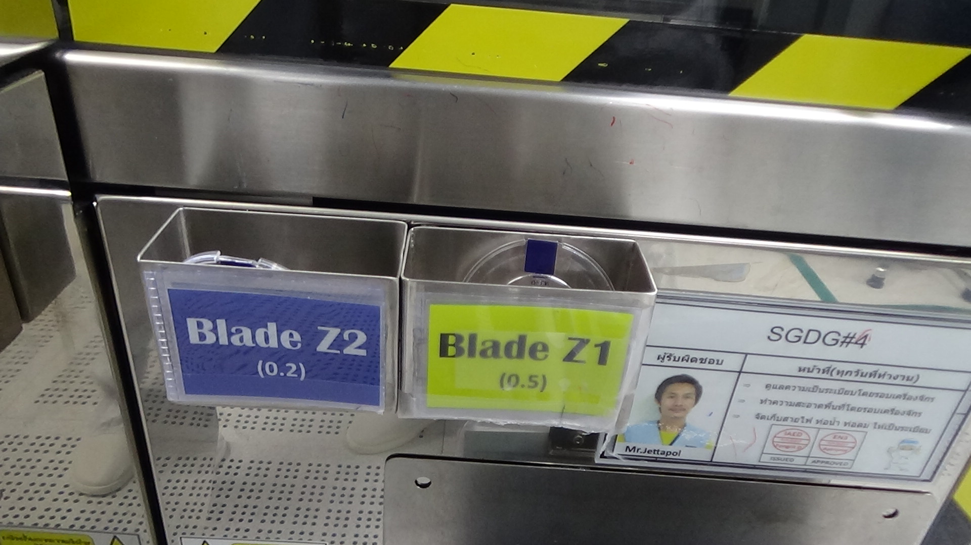
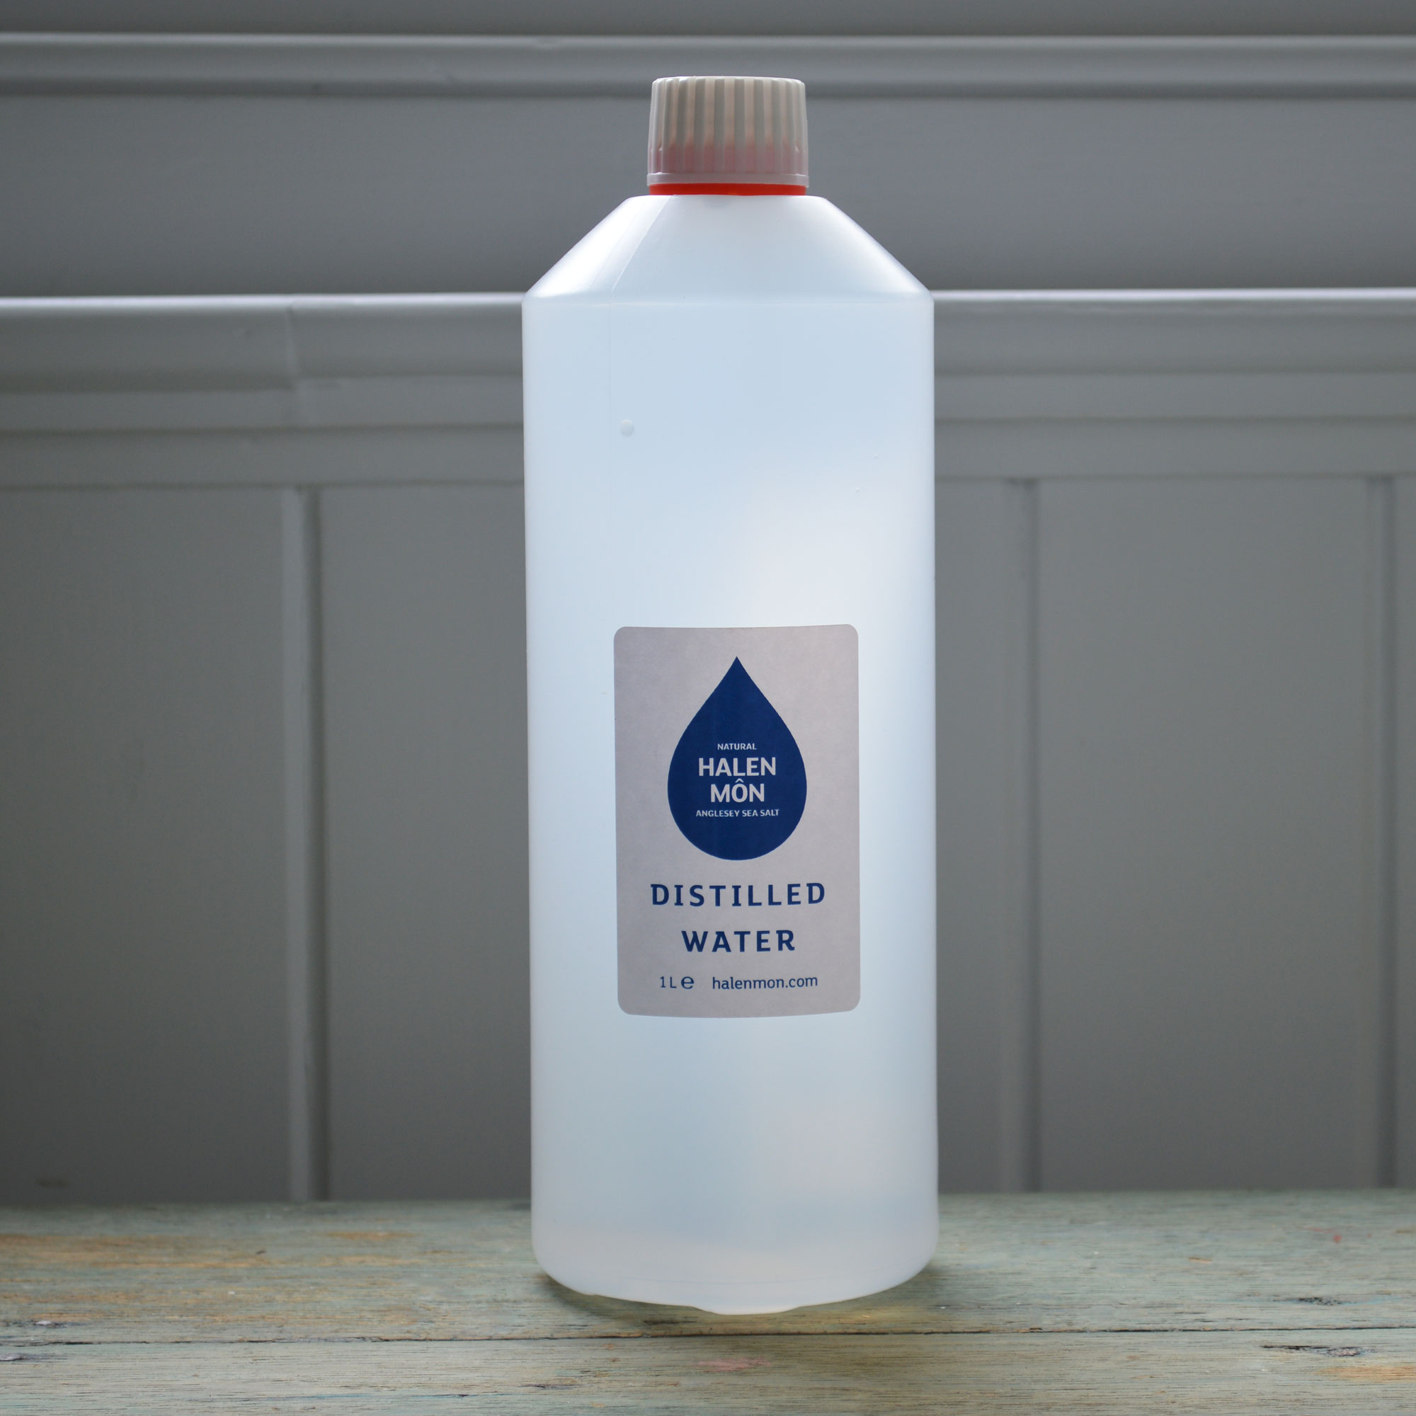
IPO of SG Dicing
Input
Process
Output
Plate glass after Mount in magazine
Blade
Plate glass dicing by Blade
with DI water
Seal glass after Dicing process in magazine
DI water

Slide 15
CHANGE BLADE Z1, Z2
Standard time summary
Flow Operation
Change blade has 5 activities, 51 elements and total average time is 31 minutes 17 seconds
MC have to change blade
PREPARE
Activity | Element | Plan (times) | Standard time (mm:ss) |  |  | Average time (mm:ss) | Frequency/ time | Total time (mm:ss)
 |  |  | 1st | 2nd | 3rd
1. Prepare | 3 | 3 | 01:27 | 01:40 | 01:17 | 01:28 | 1 | 01:28
2. Change Blade Z1 | 14 | 3 | 07:34 | 09:33 | 11:40 | 09:36 | 1 | 09:36
3. Change Blade Z2 | 22 | 3 | 10:54 | 12:36 | 09:28 | 10:59 | 1 | 10:59
4. Measure | 7 | 3 | 04:35 | 06:26 | 05:55 | 05:39 | 1 | 05:39
5. Record | 5 | 3 | 03:33 | 03:45 | 03:29 | 03:36 | 1 | 03:36
Total | 51 | 12 | 28:03 | 34:00 | 31:49 | 31:17 |  | 31:17
CHANGE BLADE
MEASUREMENT
RECORD
MC operate

Slide 16
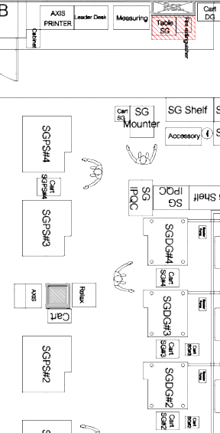
Flow Diagram of CHANGE BLADE Z1
From flow diagram, Total transportation distance is 45.6 meter and
Total transportation time is 1 minutes 25 seconds
5
Operation
Inspection
PREPARE
Distance = 7.2 m
Transportation time = 8 sec
Transportation
1
 | Drawer beside mount table that storage Blade Z1,Z2
 | SGDG Machine is changing blade
 | Cart of F-cut slice
 | IPQC booth after cut 1st slice
 | Measuring table
 | Computer desk to record information after measure
4
1
OPERATION
Distance = 2.4 m
Transportation time = 29 sec
2
3
MEASUREMENT
Distance = 25.2 m
Transportation time = 30 sec
6
4
5
2
RECORD
Distance = 10.8 m
Transportation time = 18 sec
3
6

Slide 17
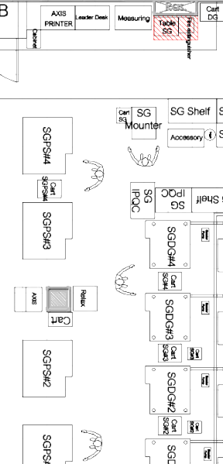
Flow Diagram of CHANGE BLADE Z2
From flow diagram, Total transportation distance is 48 meter and
Total transportation time is 1 minutes 44 seconds
5
Operation
Inspection
PREPARE
Distance = 7.2 m
Transportation time = 8 sec
Transportation
1
 | Drawer beside mount table that storage Blade Z1,Z2
 | SGDG Machine is changing blade
 | Cart of Dressing board and F-cut slice
 | IPQC booth after cut 1st slice
 | Measuring table
 | Computer desk to record information after measure
4
1
OPERATION
Distance = 4.8 m
Transportation time = 48 sec
2
3
6
MEASUREMENT
Distance = 25.2 m
Transportation time = 30 sec
4
5
2
RECORD
Distance = 10.8 m
Transportation time = 18 sec
3
6

Slide 18
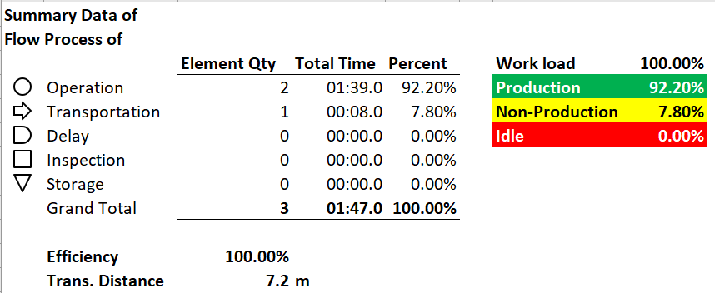
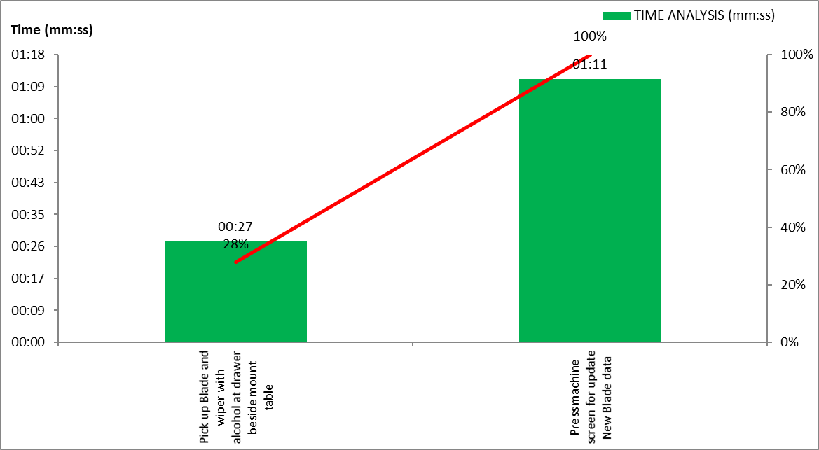
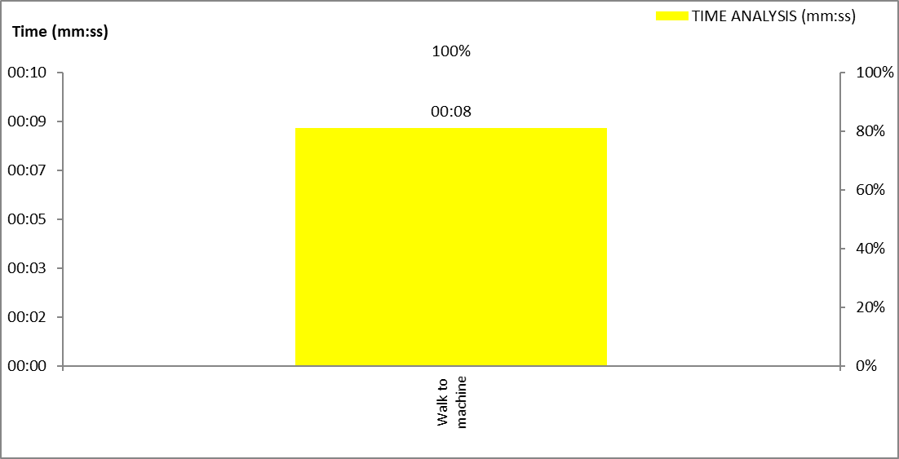
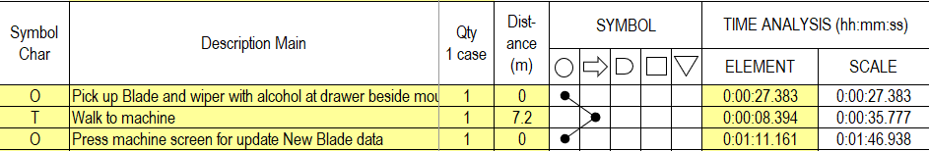
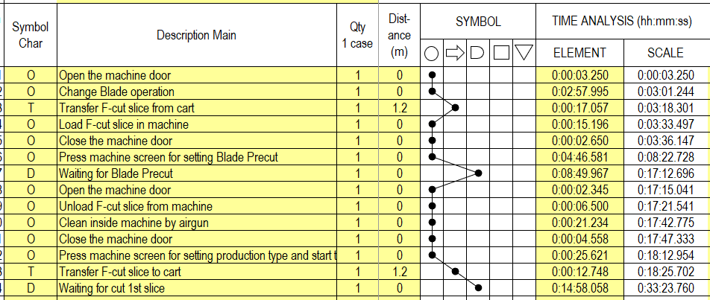
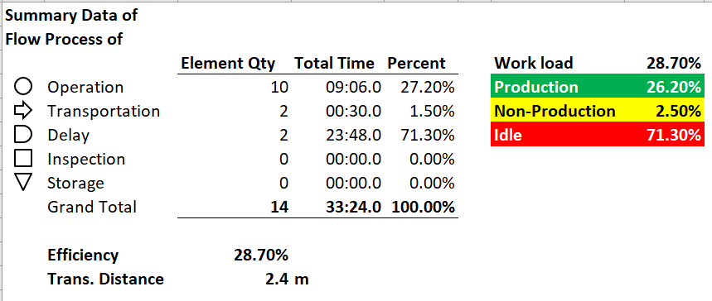
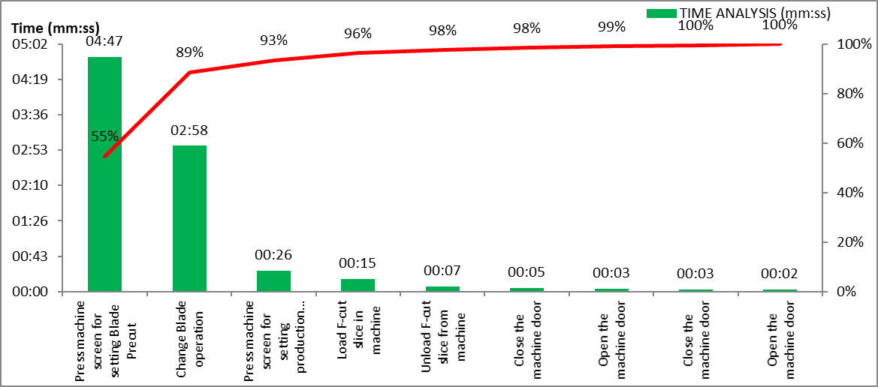
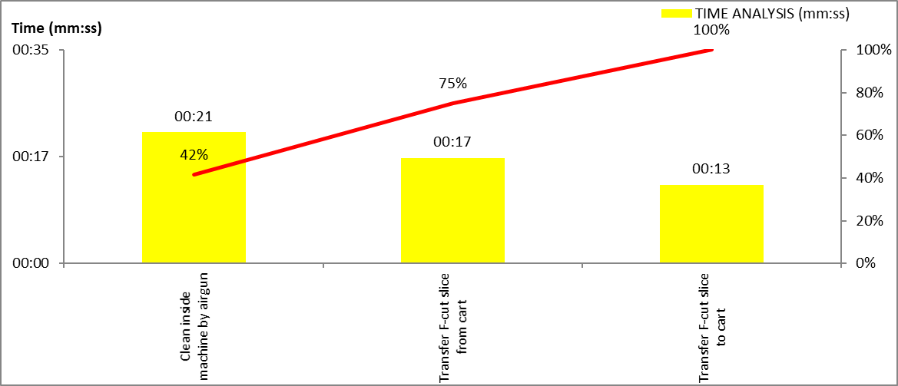
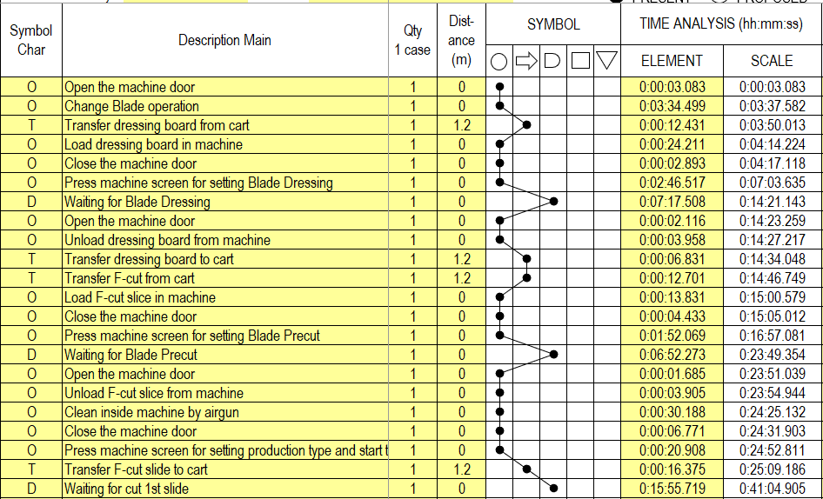
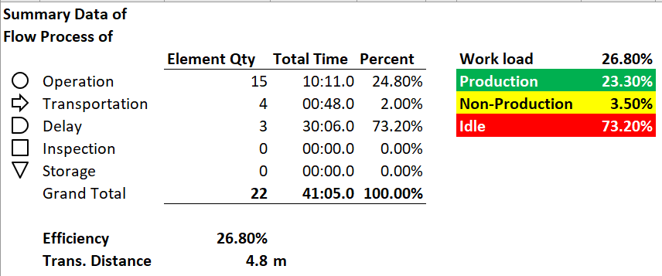
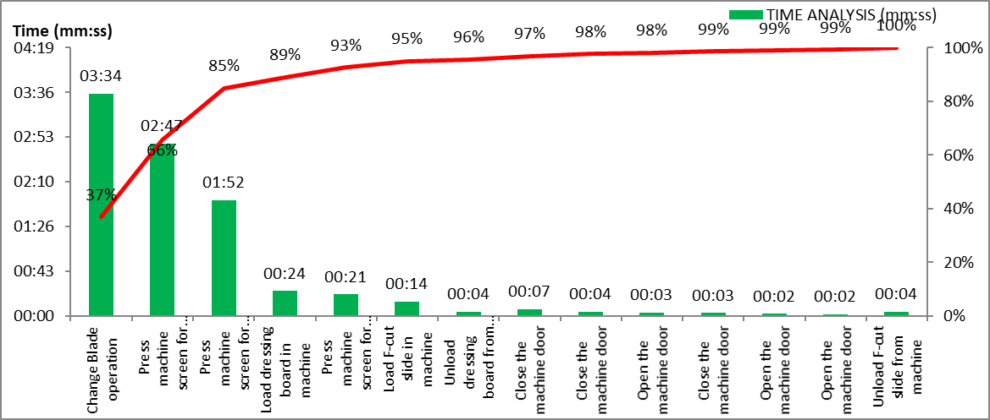
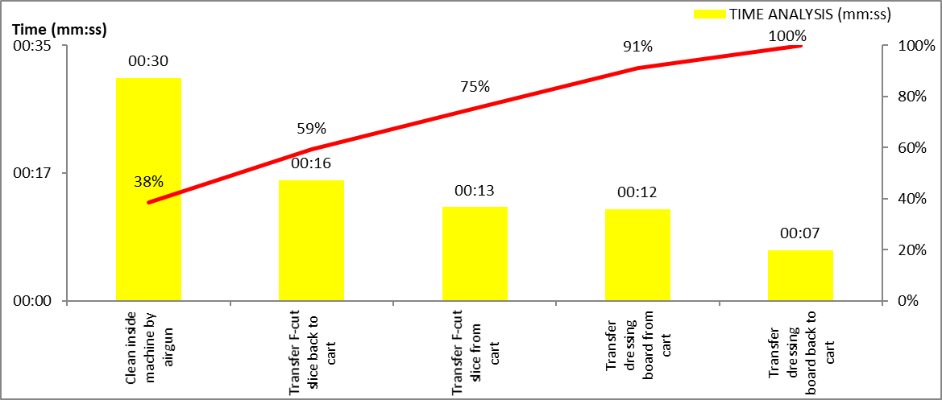
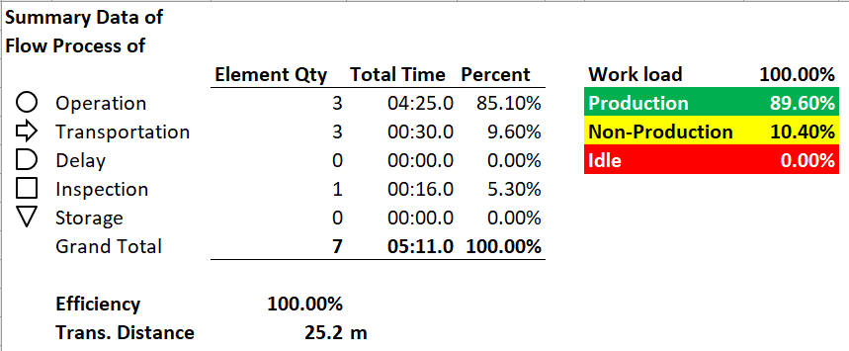
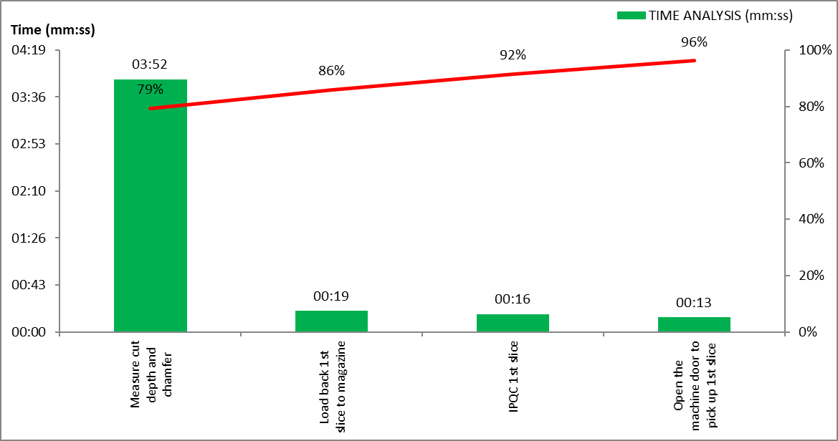
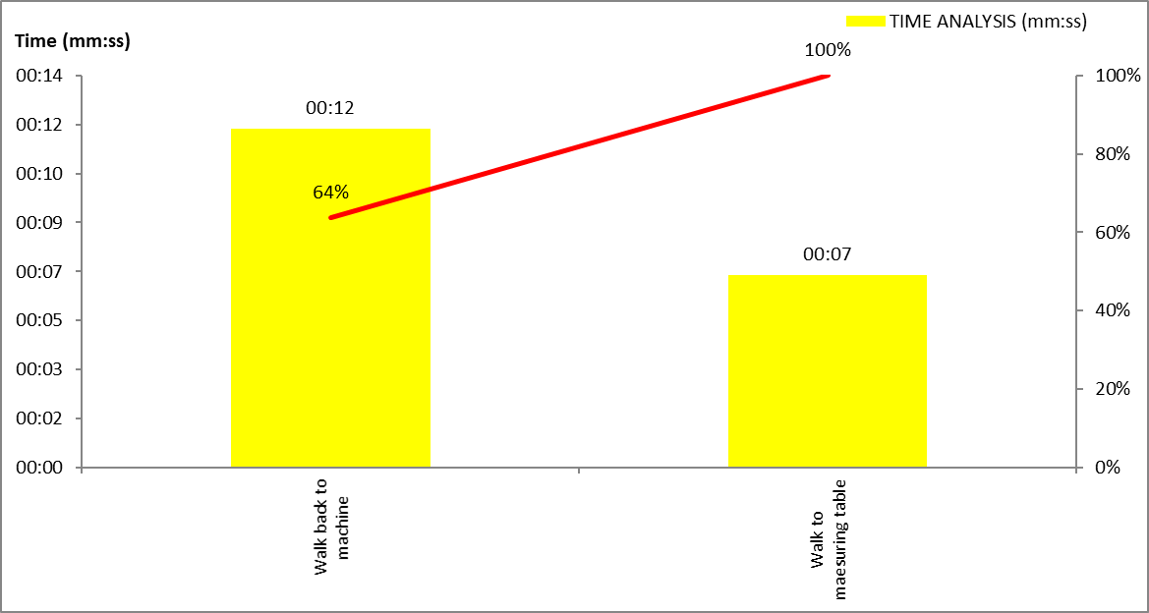
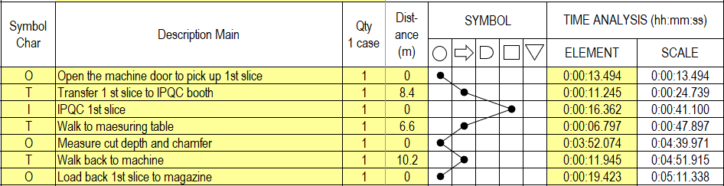
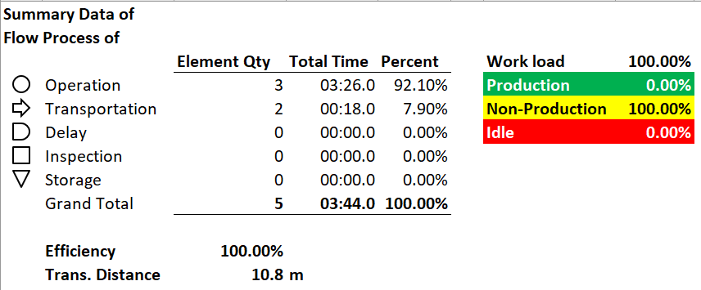
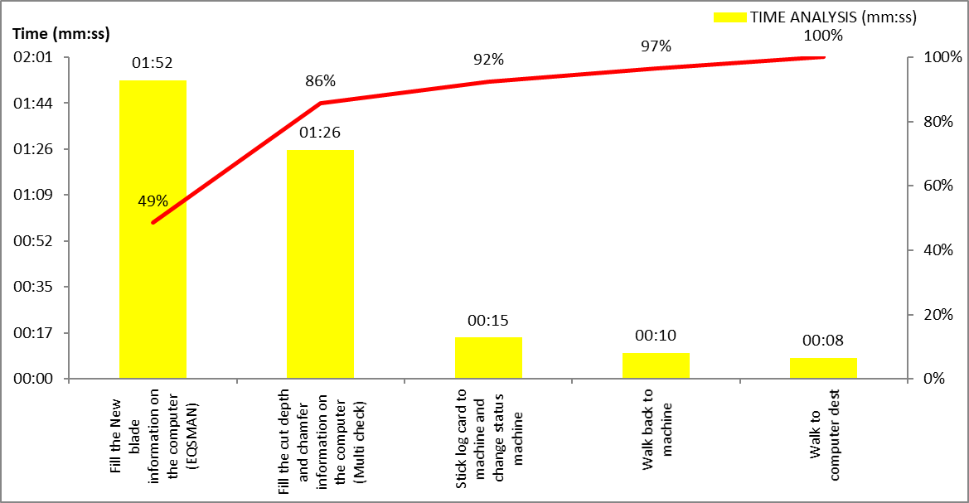
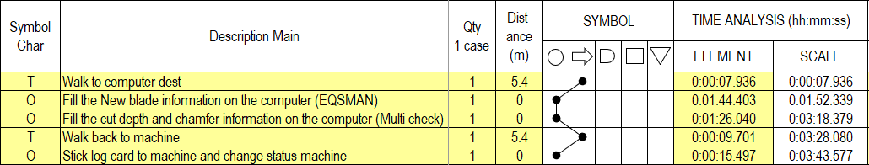
REPORT OF SG Dicing
From work load analysis has chosen Operation Z2 activity to improvement
Activity | Direct time analysis | Report | Production | Non-production | Idle
Prepare Z1, Z2 |  |  |  |  | -
Operation Z1 |  |  |  |  | -
Operation Z2 |  |  |  |  | -
Measurement |  |  |  | - | -
Record |  |  | - |  | -

Slide 19
REPORT of PREPARE Change Blade Z1,Z2
From flow process chart, will get 5 symbols of process chart and
Pareto graph. So, operation activity has production 92.2%, non-production
7.8% and idle 0%
Pareto graph
Flow process chart
Direct time analysis
Report
Report

Slide 20
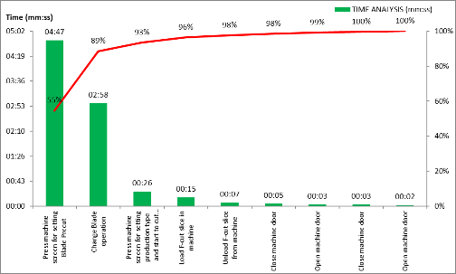
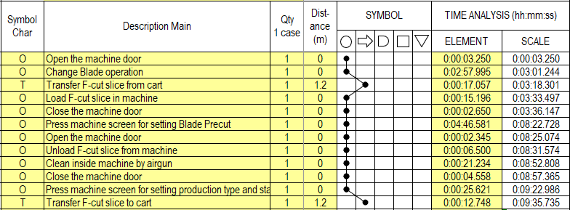
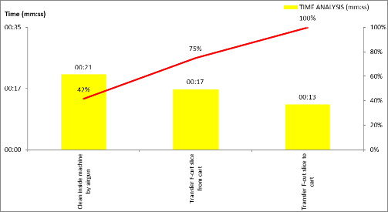

REPORT of OPEARTION Change Blade Z1
From flow process chart, will get 5 symbols of process chart and
Pareto graph. So, operation activity has production 91.1%, non-production
8.9% and idle 0%
Pareto graph
Flow process chart : Direct time analysis
Report

Slide 21
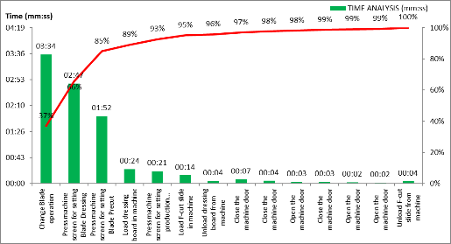



REPORT of OPEARTION Change Blade Z2
From flow process chart, will get 5 symbols of process chart and
Pareto graph. So, operation activity has production 87.1%, non-production
12.9% and idle 0%
Pareto graph
Flow process chart
Direct time analysis
Report

Slide 22
REPORT of MEASUREMENT Change Blade Z1,Z2
From flow process chart, will get 5 symbols of process chart and
Pareto graph. So, operation activity has production 89.6%, non-production
10.4% and idle 0%
Pareto graph
Flow process chart : Direct time analysis
Report

Slide 23
REPORT of RECORD Change Blade Z1,Z2
From flow process chart, will get 5 symbols of process chart and
Pareto graph. So, record activity has only non-production 100% and
EQSMAN element is the most time to use in record
Flow process chart
Direct time analysis
Pareto graph
Report

Slide 24
ACTUAL TIME SUMMARY
After measure standard time and analyze data found improvement method at Prepare activity and Operation of Z2 activity.
Process | Activity | Element | Actual Time (mm:ss) | Distance (m) | Improvement (activity) | Remark
SG Mount | 1. Prepare | 17 | 04:16 | 54 | Prepare | Improve at Prepare activity in store bag in bag box element
 | 2. Mount | 7 | 30:12 | 0
 | 3. After (End lot, Record) | 14 | 07:52 | 34.8
SGDG (Change Blade) | Prepare | 3 | 01:28 | 7.2 | Operation Z2 | Improve at Operation Z2 in Transfer slice for prepare Blade dressing and Pre-cut elements
 | 2. Change Blade Z1 | 14 | 33:24 | 2.4
 | 3. Change Blade Z2 | 22 | 41:15 | 4.8
 | 4. Measurement | 7 | 05:39 | 25.2
 | 5. Record | 5 | 03:36 | 10.8

Slide 25
ANALYSIS &
IMPROVEMENT
. . . . . . . .
. . . . . . . .
AGENDA
Select activity
Analysis
3) Improvement
4) Summary of Improvement

Slide 26



Select Store bag in box activity to analysis
1
A lot of air inside bag
2
After get plate glass box from W/H must be unpack and store bag in box.
Operator store bag one by one
27 sec/time
1
Operator removes all bags and folding new bag then put all bag in box.
186 sec/time
(4 bag)
2
Too small box
Due to total time is around 213 so I would like to analysis on activity

Slide 27
SG Mount : ECRS ANALYSIS
Store bag in box element take a long time because difficult to store and pick up so these elements suitable to simplify according to ECRS method
ECRS |  | Reason
Eliminate | NO | Can’t be eliminate because must be store bag in bag box for wrap empty plate glass box before sent to W/H
Combine | NO | Can’t be combine because there are no activities to combine
Rearrange | NO | Can’t be rearrange because must be store bag after unpack plate glass box
Simplify | YES | Create new box that help to convenient in store bag and pick up when want bag to wrap plate glass box

Slide 28
SG Mount : IMPROVEMENT
A
Motor
button
Partition
control
Handle lid
A
White Bag
Blue Bag
Right
Front
Section A-A
Method
Function is motor roll bar to expel the air inside bag to make the bag flat and easy to store in box including contain many bags.
Bag has 2 types that is White and Blue Bag. Number of Blue bags have more than White bag in order to classify so made a partition to separate type of bag in ratio about 60:40
How to used
1. The bags are classified by press partition control that white bag is on right side and blue bag is on left side.
2. Fold the bag in half lengthwise and put it in box above
3. Press motor button for store bag in box
4. Open the box in right side and pick up bag when have to wrap plate glass box

Slide 29



SG Mount : IMPROVEMENT
BEFORE
AFTER
Total time of store bag in bag box max is 47 sec/time
Difficult to store bag in bag box because bag is tightly in box and box is too small
Difficult to pick up from bag box because when take out often sticking up several bags
Simulation total time of store bag in bag box around 25 sec/time (Reduce time about 46.81%)
Reduce difficult to store and pick up bag

Slide 30




Select Transfer slices activity to analysis
Activity | Element | Time (sec) | Distance (meter)
Operation | Transfer dressing board from cart | 12 | 1.2
 | Transfer dressing board back to cart | 7 | 1.2
 | Transfer F-cut slice from cart | 13 | 1.2
 | Transfer F-cut slice back to cart | 16 | 1.2
Total |  | 48 | 4.8
After change blade Z2 operation must has blade dressing and Pre-cut element
There are transportations 4 times for prepare slice.
I would like to analysis on activity

Slide 31
Change Blade Z2 : ECRS ANALYSIS
There are 4 elements that duplicate on transportation so these elements suitable to combine according to ECRS method
ECRS |  | Reason
Eliminate | NO | Can’t be eliminate because these elements are preparing slice for Blade Dressing and Pre-cut after change blade
Combine | YES | Combine elements that transfer F-cut slice and Dressing Board between machine and cart because there are same distance
Rearrange | NO | Can’t be rearrange because must be prepare slice before Blade Dressing
Simplify | NO | Can’t be simplify because must be select slice in magazine at cart and transfer to machine

Slide 32




Change Blade Z2 : IMPROVEMENT
BEFORE
AFTER
Operator | Machine
Operator | Machine
1. Go to pick up dressing board
1,3 Go to pick up dressing board and F-cut slice
Blade dressing
Blade dressing
2. Back to cart for store dressing board
Pre-cut
3. Pick up F-cut slice
2,4 Back to cart for store dressing board and F-cut slice
Pre-cut
4. Back to cart for store F-cut slice
Simulation Total time is around 32 sec and total transportation is around 2.4 meter (Reduce time about 33.33%)
Total time is around 48 sec and total transportation is around 4.8 meter

Slide 33
SUMMARY OF IMPROVEMENT
Summary of Improvement that show result after improvement as follow Store bag in bag box element can reduce work time around 46.81% and Transfer slice for prepare Blade dressing and Pre-cut element can Reduce work time around 33.33%
Element | Detail Improvement | Actual Time (sec) | Improvement Time (sec) | Result
Store bag in bag box | Create new box that help to convenient in store bag and use when want bag to wrap plate glass box | 47 | 25 | Reduce work time around 46.81%
Transfer slice for prepare Blade dressing and Pre-cut | Combine elements that transfer F-cut slice and Dressing Board between machine and cart because there are same distance | 48 | 32 | Reduce work time around 33.33%

Slide 34
The results of Internship
Internship for 2 months (23 May 2022 – 27 July 2022), Monday – Friday (8.00 a.m. – 17.30 p.m.)
To getting practical work experience from internship
To learning preparing appropriate presentation
To learning apply work study with working
To learning how to deal with many problem
To practice analyze and solve the problem

Slide 35


